Slide 1

Riemann Sums and Definite Integrals
4.3
Copyright © Cengage Learning. All rights reserved.

Slide 2
Objectives
Understand the definition of a Riemann sum.
Evaluate a definite integral using limits.
Evaluate a definite integral using properties of definite integrals.

Slide 3
Riemann Sums

Slide 4

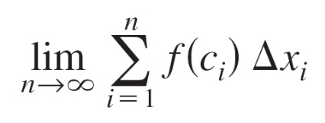
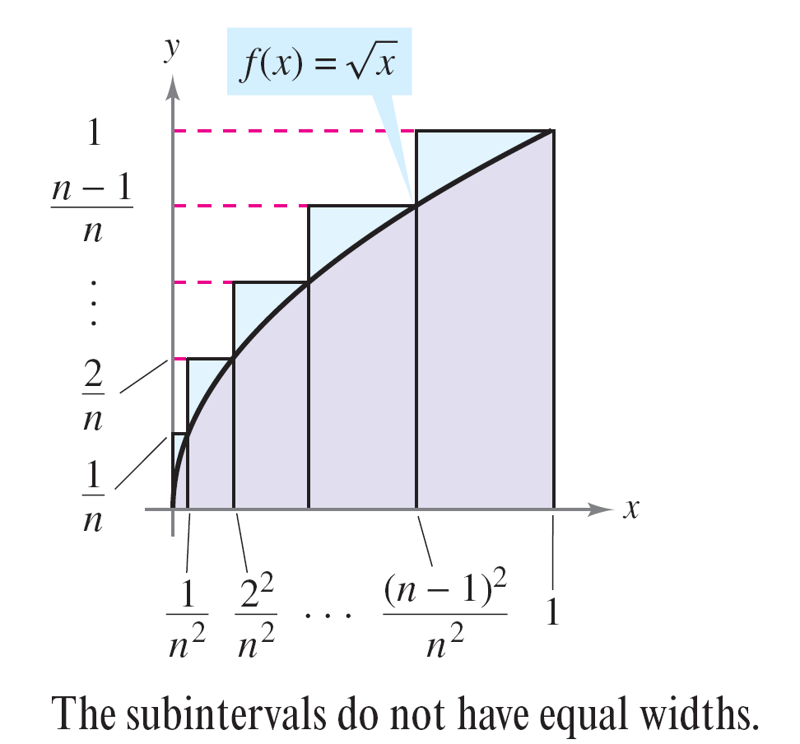
Example 1 – A Partition with Subintervals of Unequal Widths
Consider the region bounded by the graph of and the x-axis for 0 ≤ x ≤ 1, as shown in Figure 4.17. Evaluate the limit
where c_{i} is the right endpoint
of the partition given by
c_{i} = i²/n² and Δx_{i} is the width
of the ith interval.
Figure 4.17

Slide 5
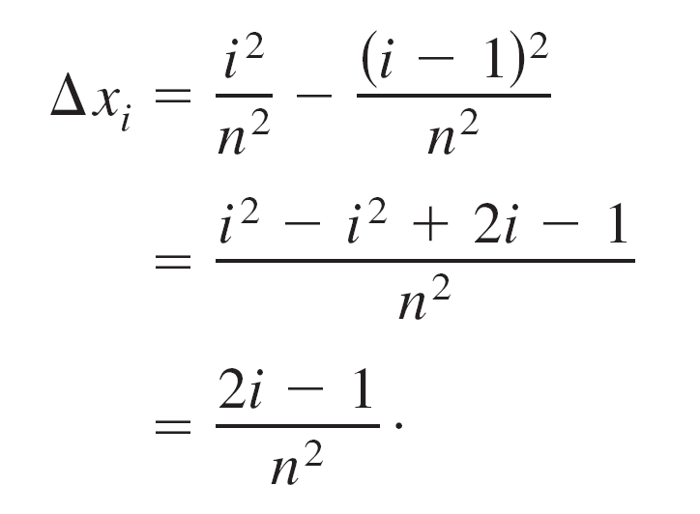
Example 1 – Solution
The width of the ith interval is given by

Slide 6
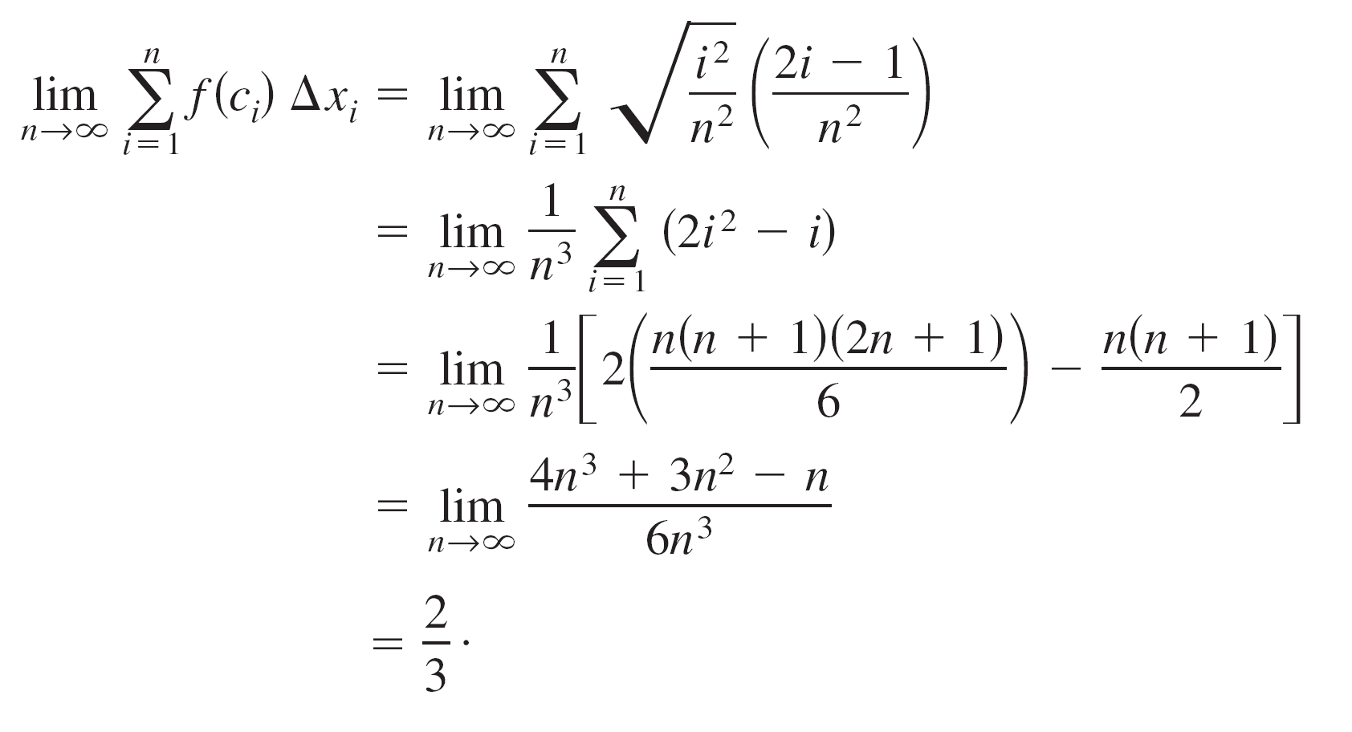
Example 1 – Solution
cont’d
So, the limit is

Slide 7

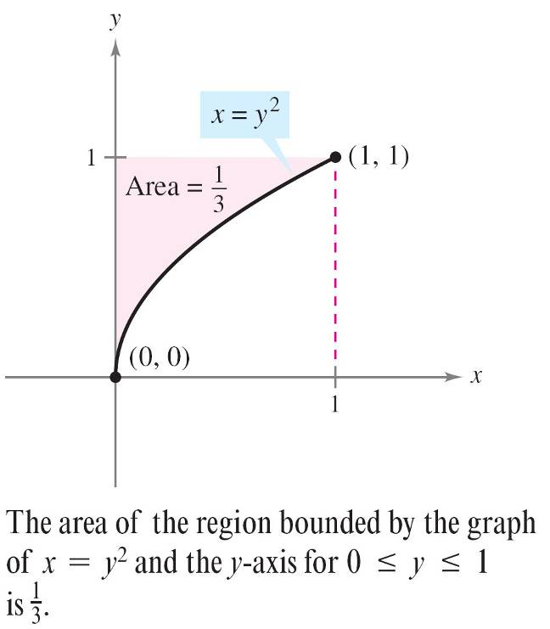
Riemann Sums
We know that the region shown in Figure 4.18 has an area of .
Figure 4.18

Slide 8

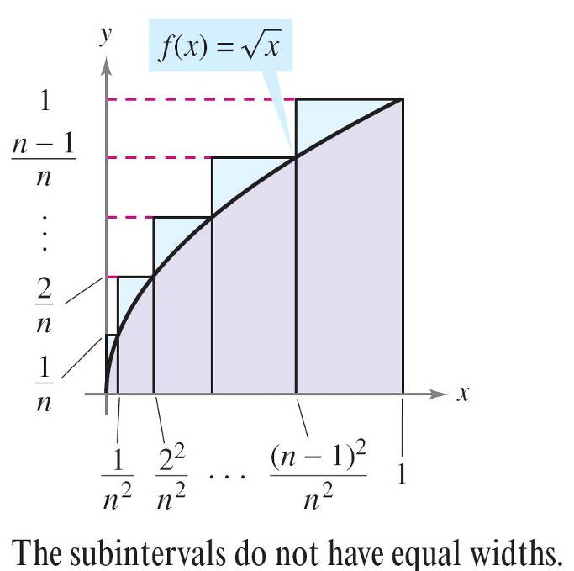
Riemann Sums
Because the square bounded by 0 ≤ x ≤ 1 and 0 ≤ y ≤ 1
has an area of 1, you can conclude that the area of the
region shown in Figure 4.17 has an area of .
Figure 4.17

Slide 9
Riemann Sums
This agrees with the limit found in Example 1, even though that example used a partition having subintervals of unequal widths.
The reason this particular partition gave the proper area is that as n increases, the width of the largest subinterval approaches zero.
This is a key feature of the development of definite integrals.

Slide 10
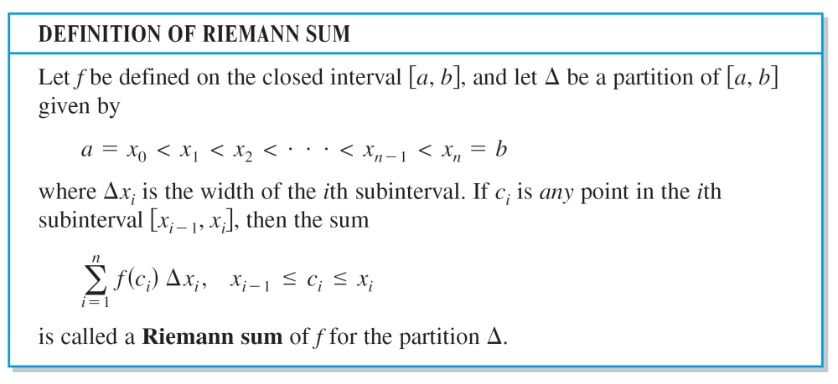
Riemann Sums

Slide 11
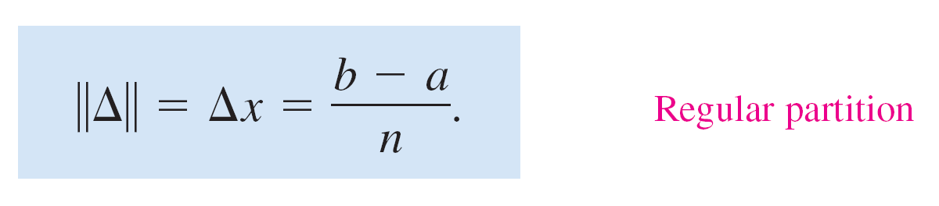
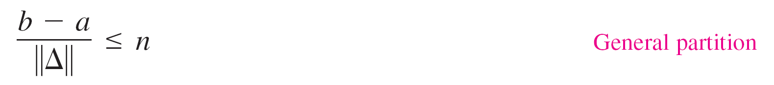
Riemann Sums
The width of the largest subinterval of a partition Δ is the norm of the partition and is denoted by ||Δ||.
If every subinterval is of equal width, the partition is regular
and the norm is denoted by
For a general partition, the norm is related to the number of subintervals of [a, b] in the following way.

Slide 12

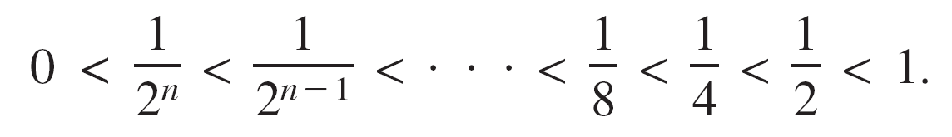
Riemann Sums
So, the number of subintervals in a partition approaches infinity as the norm of the partition approaches 0.
That is, ||Δ||→0 implies that
The converse of this statement is not true. For example, let Δ_{n} be the partition of the interval [0, 1] given by

Slide 13


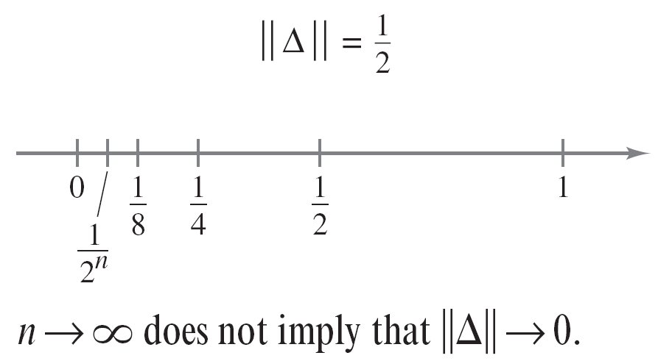
Riemann Sums
As shown in Figure 4.19, for any positive value of n, the norm of the partition Δ_{n} is
So, letting n approach infinity does not force ||Δ|| to approach 0. In a regular partition, however, the statements ||Δ||→0 and are equivalent.
Figure 4.19

Slide 14
Definite Integrals

Slide 15
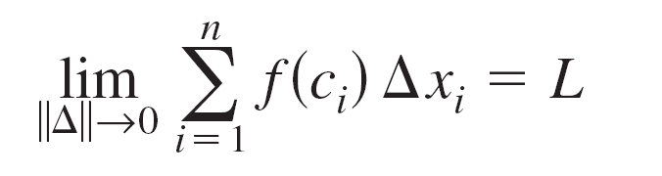
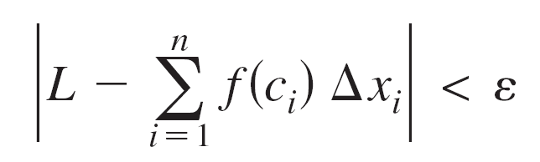
Definite Integrals
To define the definite integral, consider the following limit.
To say that this limit exists means there exists a real number L such that for each ε > 0 there exists a δ > 0 so that for every partition with ||Δ|| < δ it follows that
regardless of the choice of c_{i} in the ith subinterval of each partition Δ.

Slide 16
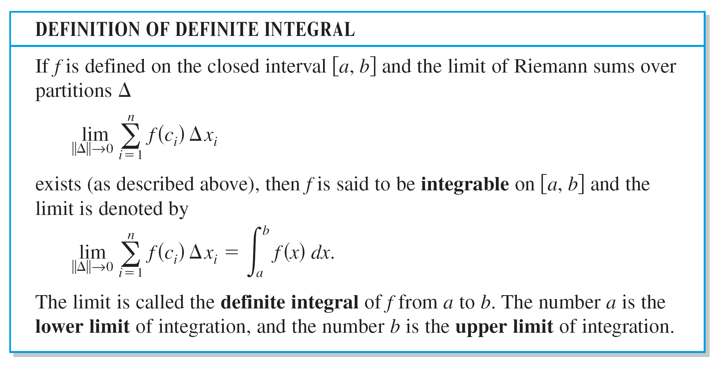
Definite Integrals

Slide 17
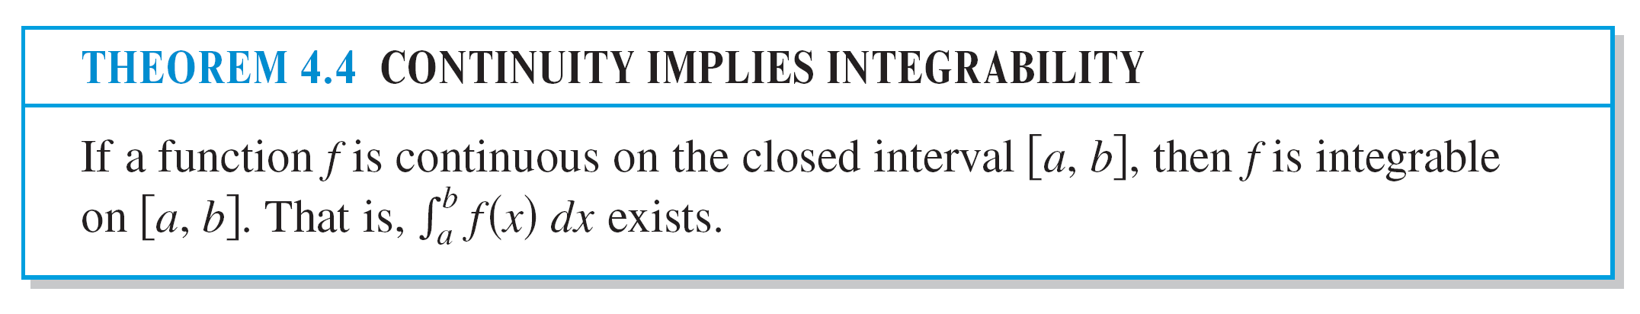
Definite Integrals

Slide 18
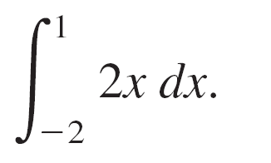
Example 2 – Evaluating a Definite Integral as a Limit
Evaluate the definite integral
Solution:
The function f(x) = 2x is integrable on the interval [–2, 1] because it is continuous on [–2, 1].
Moreover, the definition of integrability implies that any partition whose norm approaches 0 can be used to determine the limit.

Slide 19
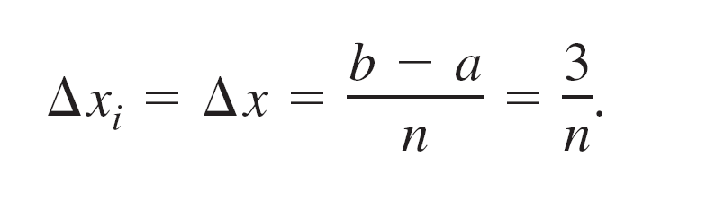
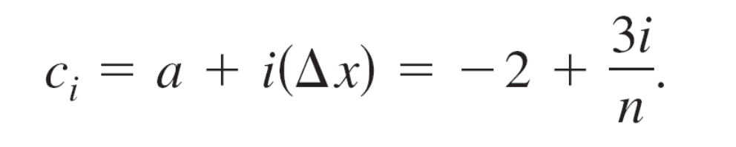
Example 2 – Solution
cont’d
For computational convenience, define Δ by subdividing [–2, 1] into n subintervals of equal width
Choosing c_{i} as the right endpoint of each subinterval produces

Slide 20
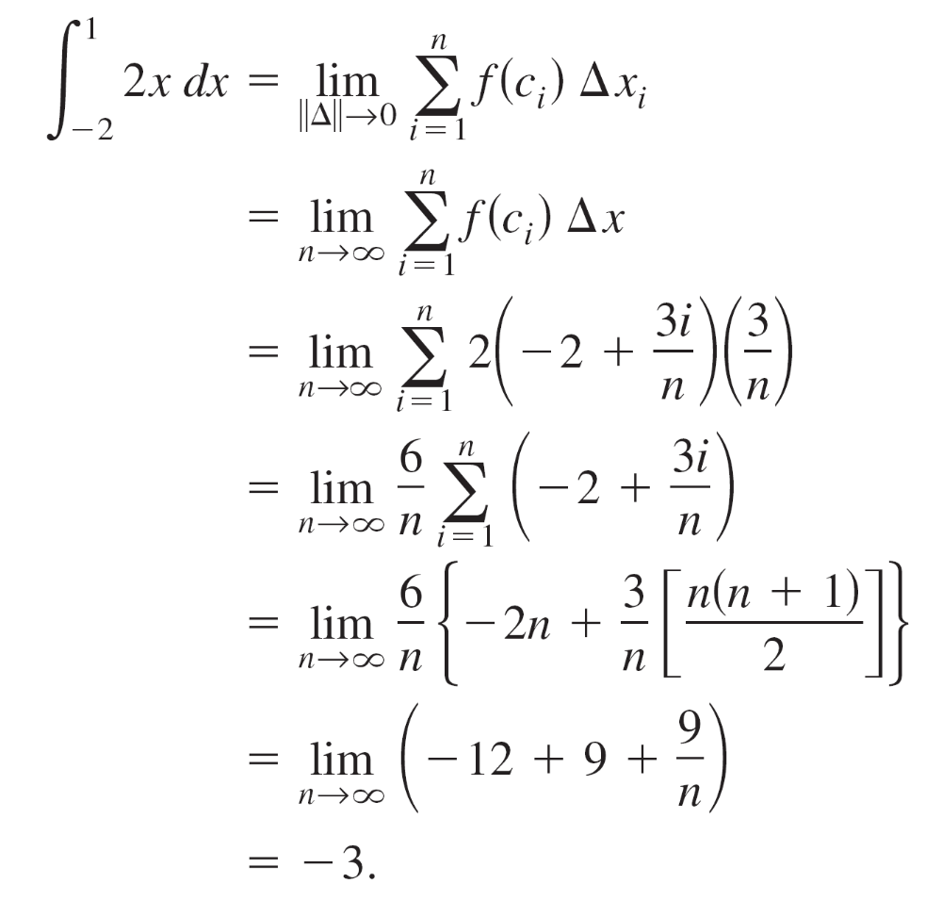
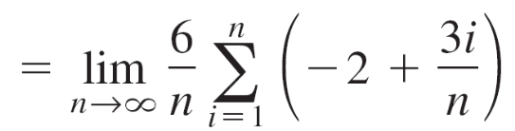
Example 2 – Solution
cont’d
So, the definite integral is given by

Slide 21
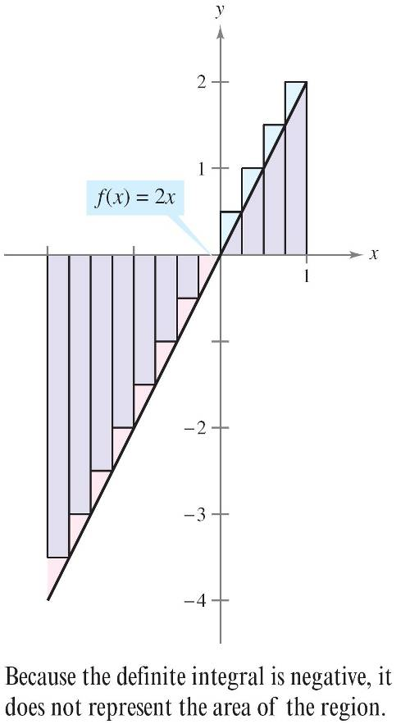
Definite Integrals
Because the definite integral in Example 2 is negative, it does not represent the area of the region shown in
Figure 4.20.
Definite integrals can be
positive, negative, or zero.
For a definite integral to be
interpreted as an area, the
function f must be continuous
and nonnegative on [a, b],
as stated in the following theorem.
Figure 4.20

Slide 22
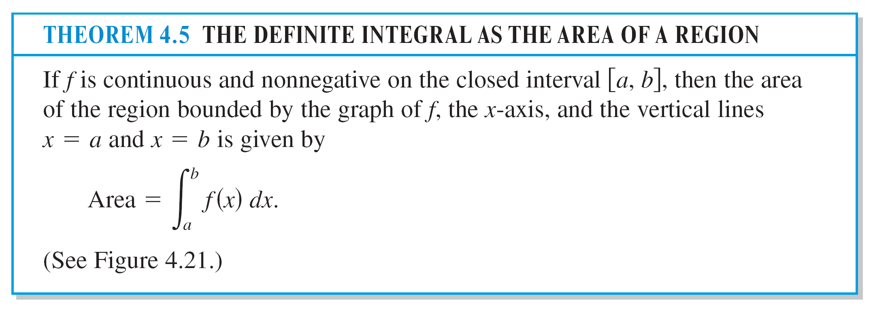
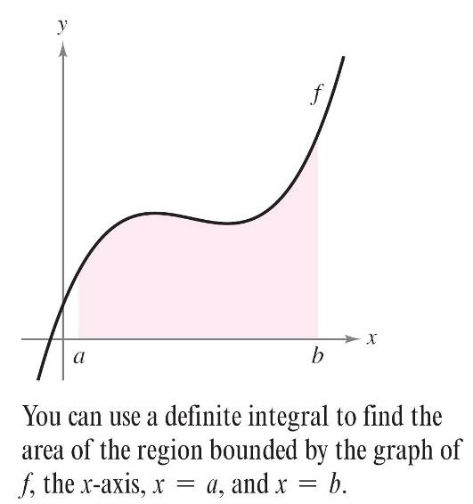
Definite Integrals
Figure 4.21

Slide 23
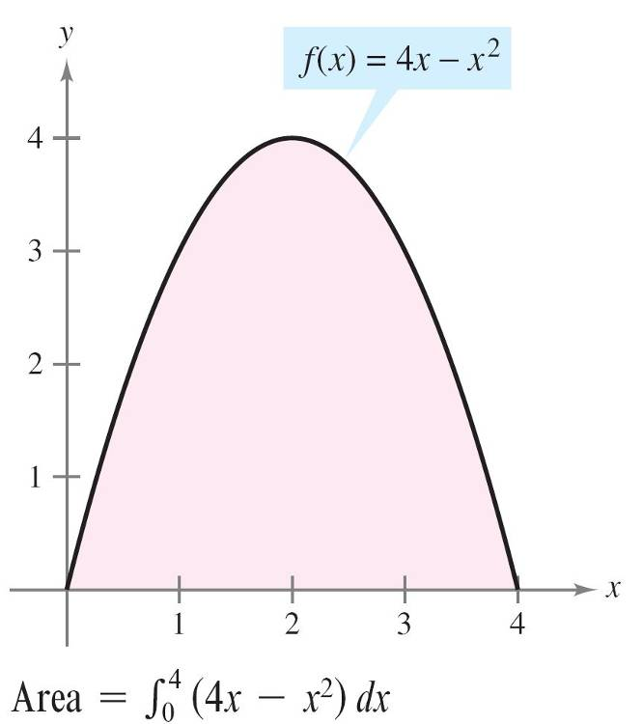
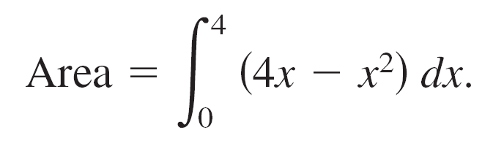
Definite Integrals
As an example of Theorem 4.5, consider the region
bounded by the graph of f(x) = 4x – x² and the x-axis, as
shown in Figure 4.22.
Because f is continuous and
nonnegative on the closed
interval [0, 4], the area of the
region is
Figure 4.22

Slide 24
Definite Integrals
You can evaluate a definite integral in two ways—you can use the limit definition or you can check to see whether the definite integral represents the area of a common geometric region such as a rectangle, triangle, or semicircle.

Slide 25
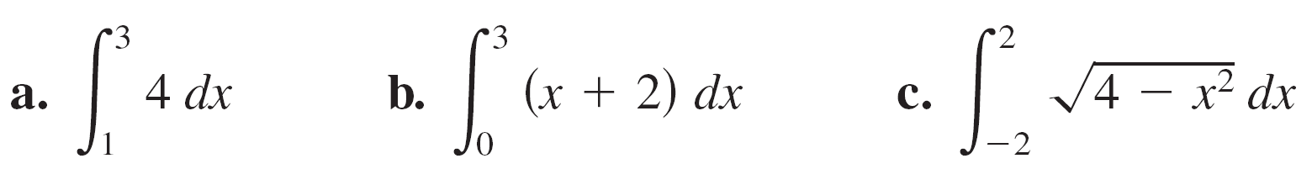
Example 3 – Areas of Common Geometric Figures
Sketch the region corresponding to each definite integral. Then evaluate each integral using a geometric formula.
a.
b.
c.

Slide 26
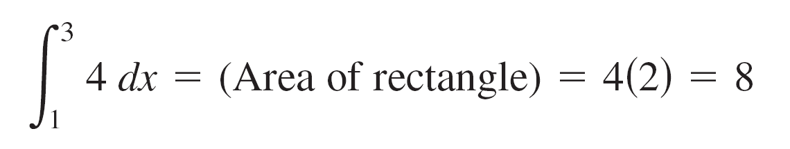
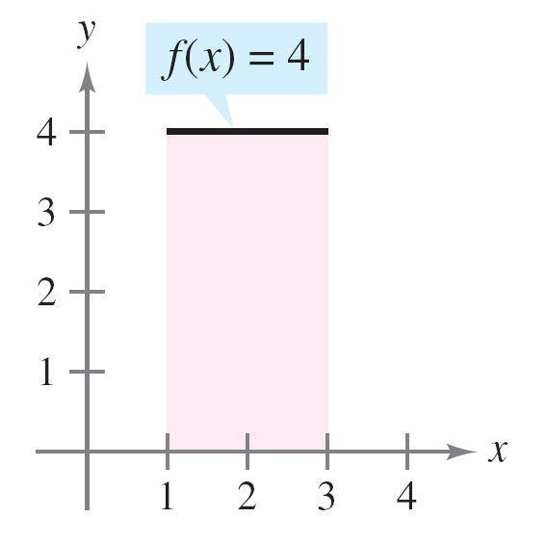
Example 3(a) – Solution
This region is a rectangle of height 4 and width 2.
Figure 4.23(a)

Slide 27
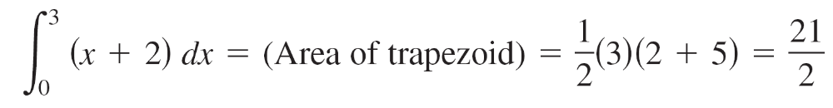
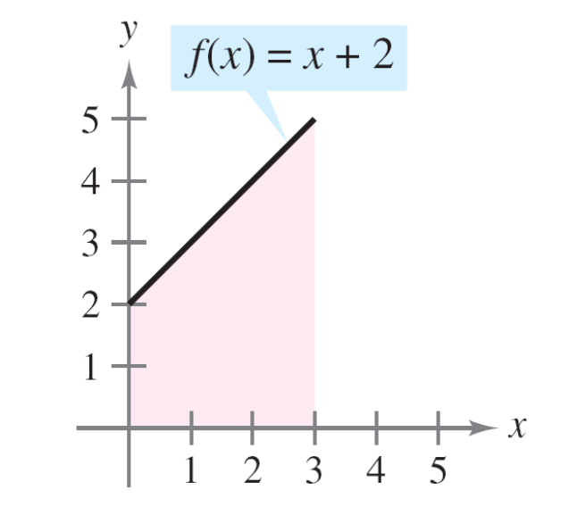
Example 3(b) – Solution
cont’d
This region is a trapezoid with an altitude of 3 and parallel bases of lengths 2 and 5. The formula for the area of a trapezoid is h(b₁ + b₂).
Figure 4.23(b)

Slide 28

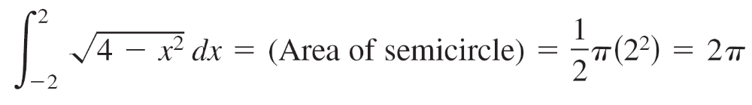
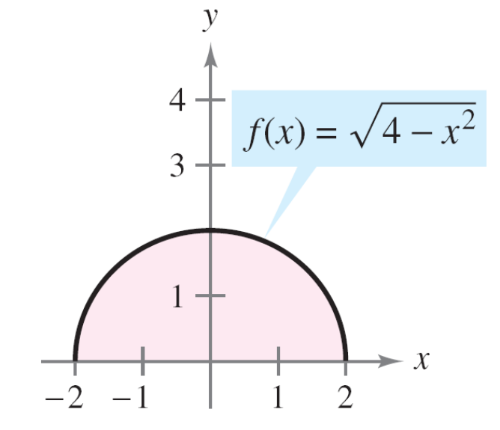
Example 3(c) – Solution
cont’d
This region is a semicircle of radius 2. The formula for the area of a semicircle is
Figure 4.23(c)

Slide 29
Properties of Definite Integrals

Slide 30
Properties of Definite Integrals
The definition of the definite integral of f on the interval [a, b] specifies that a < b.
Now, however, it is convenient to extend the definition to cover cases in which a = b or a > b.
Geometrically, the following two definitions seem reasonable.
For instance, it makes sense to define the area of a region of zero width and finite height to be 0.

Slide 31
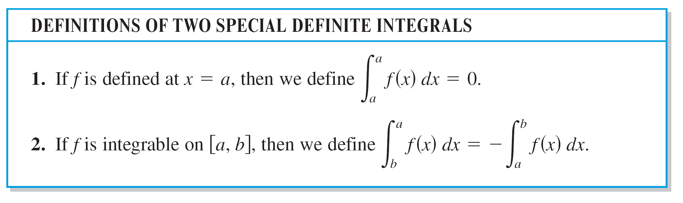
Properties of Definite Integrals

Slide 32
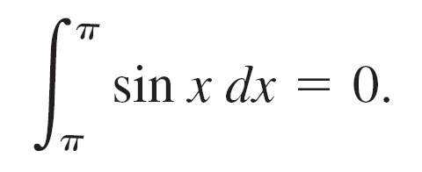


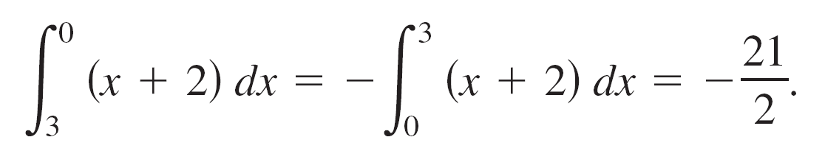
Example 4 – Evaluating Definite Integrals
a. Because the sine function is defined at x = π, and the upper and lower limits of integration are equal, you can write
b. The integral dx has a value of
you can write

Slide 33
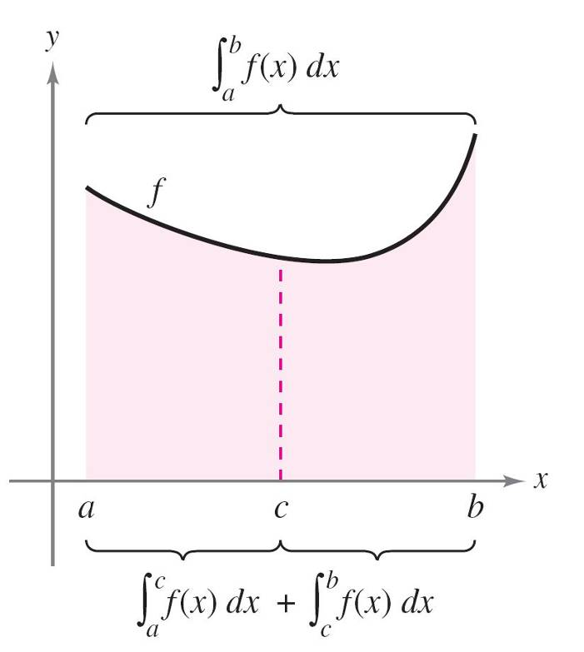
Example 4 – Evaluating Definite Integrals
cont’d
In Figure 4.24, the larger region can be divided at x = c into two subregions whose intersection is a line segment.
Because the line segment has
zero area, it follows that the
area of the larger region is equal
to the sum of the areas of the
two smaller regions.
Figure 4.24

Slide 34
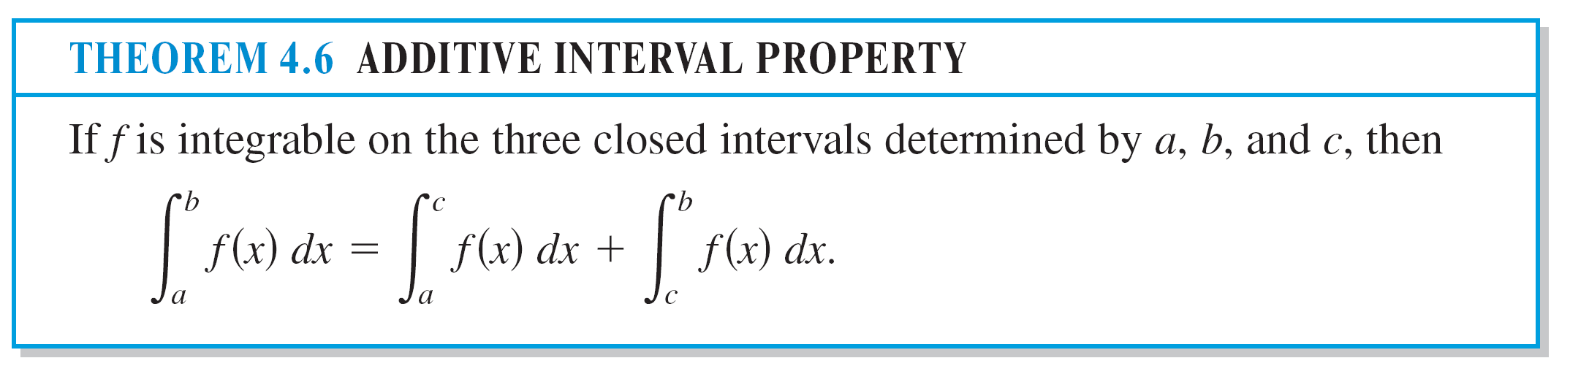
Properties of Definite Integrals

Slide 35
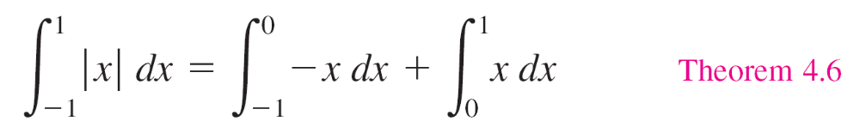
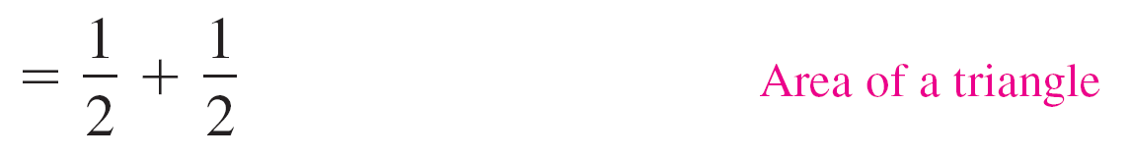

Example 5 – Using the Additive Interval Property

Slide 36
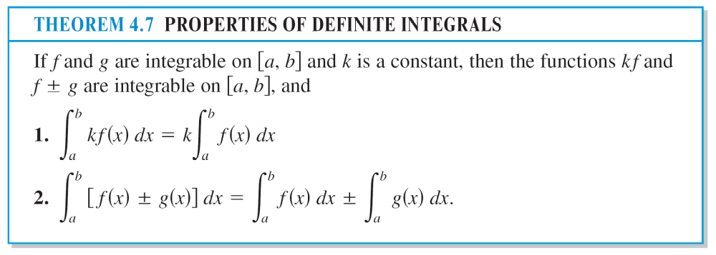
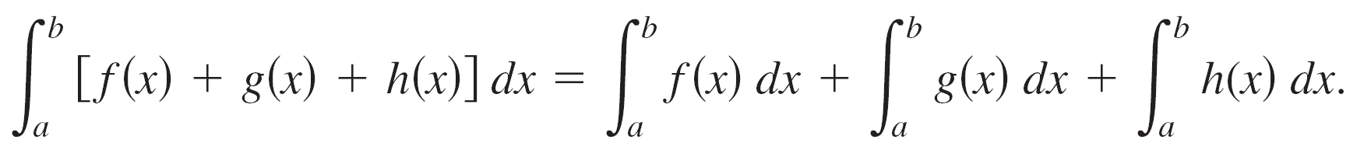
Properties of Definite Integrals
Note that Property 2 of Theorem 4.7 can be extended to cover any finite number of functions. For example,

Slide 37
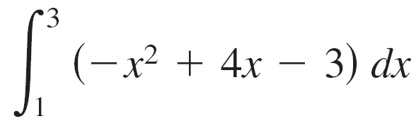
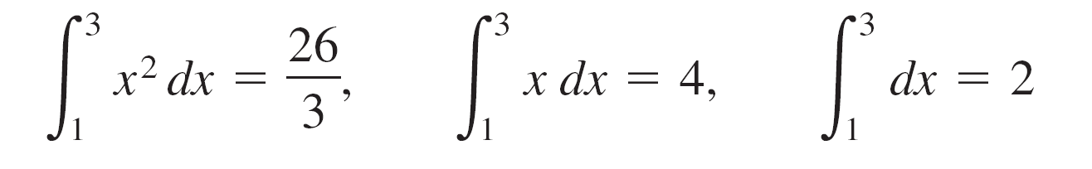
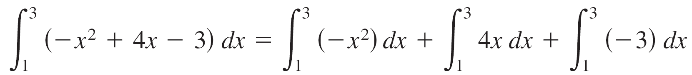
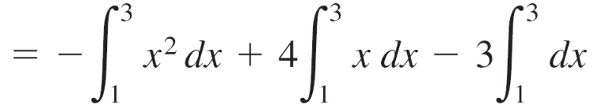
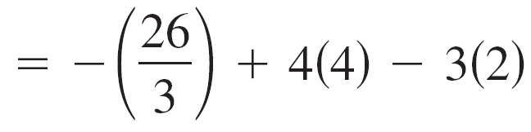
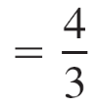
Example 6 – Evaluation of a Definite Integral
Evaluate using each of the following values.
Solution:

Slide 38
Properties of Definite Integrals
If f and g are continuous on the closed interval [a, b] and
0 ≤ f(x) ≤ g(x)
for a ≤ x ≤ b, the following properties are true.
First, the area of the region bounded by the graph of f and the x-axis (between a and b) must be nonnegative.

Slide 39
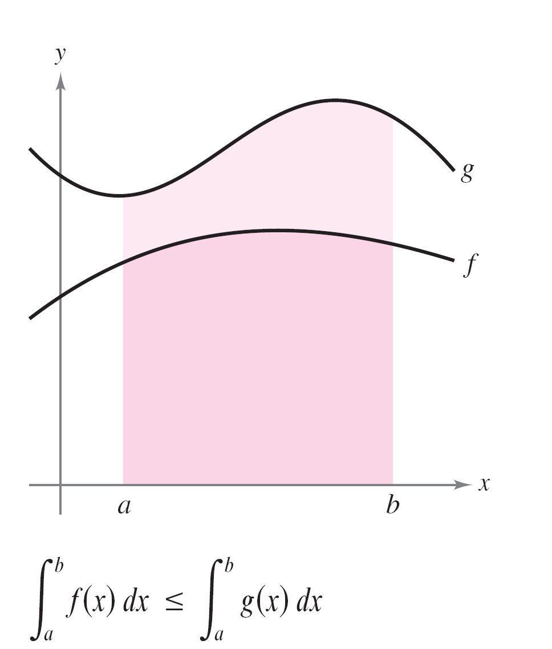
Properties of Definite Integrals
Second, this area must be less than or equal to the area of the region bounded by the graph of g and the x-axis (between a and b ), as shown in Figure 4.25.
These two properties are
generalized in Theorem 4.8.
Figure 4.25

Slide 40
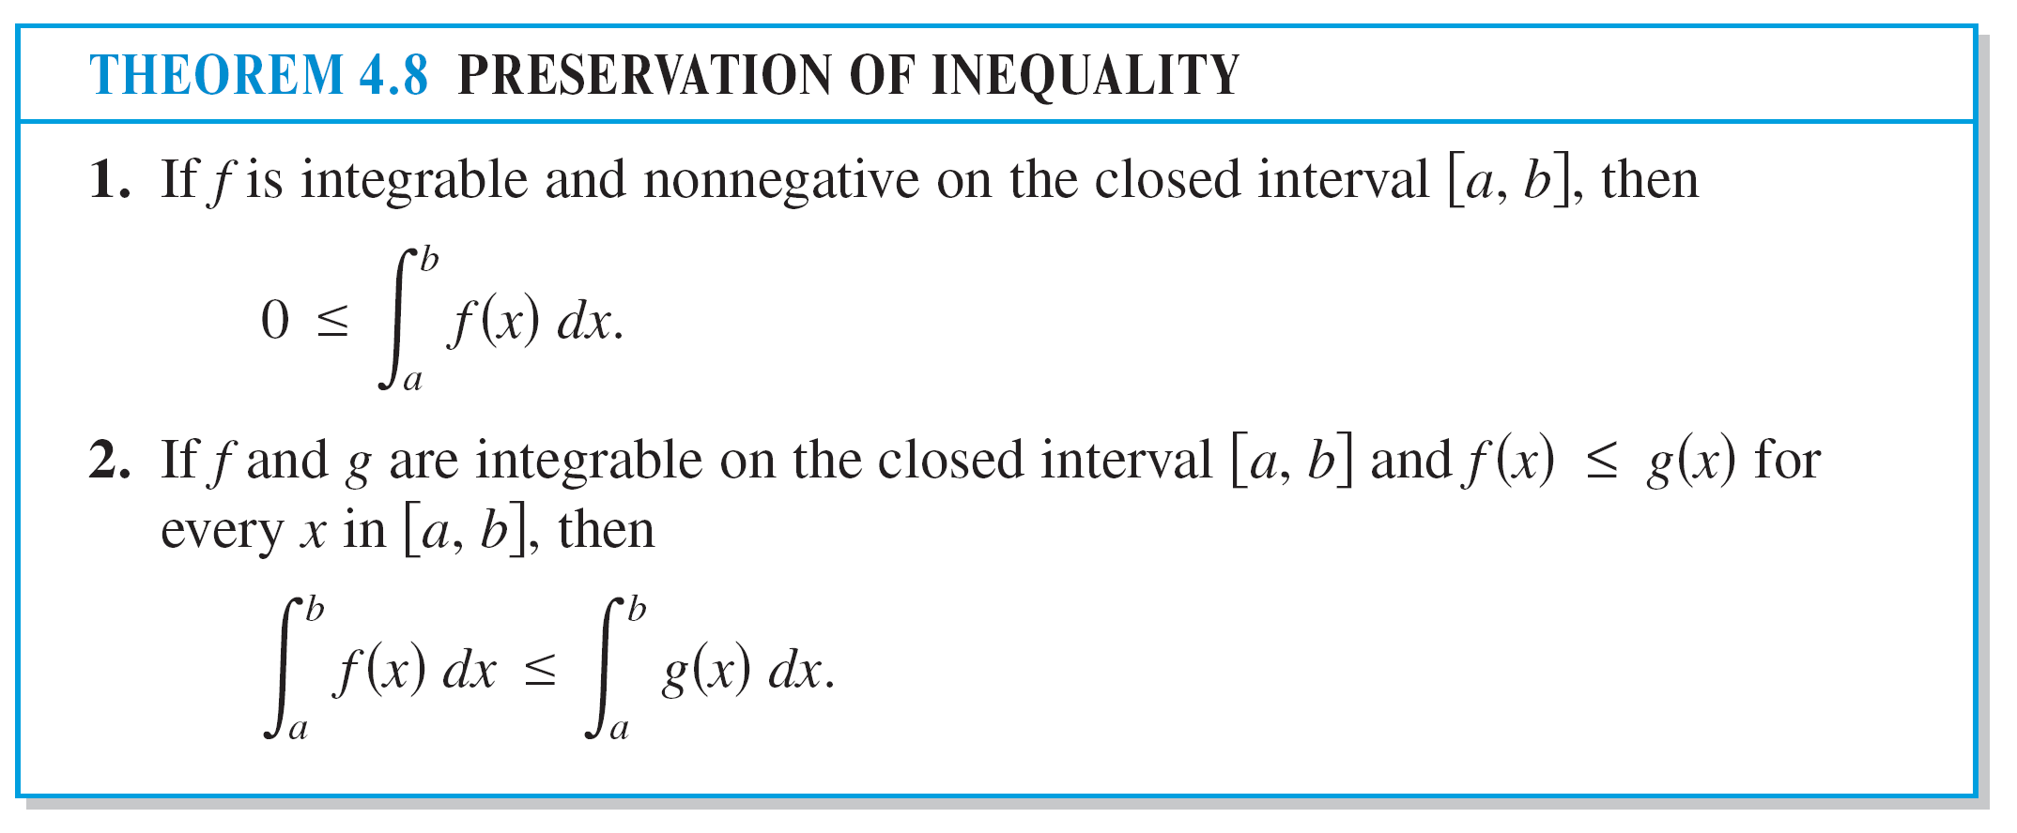
Properties of Definite Integrals

